Slide 1
Computer Network and Communication
CNS3200

Slide 2
Learning Outcome
EXPLAIN INTERNETWORKING AND RELATED PROTOCOLS I.E UNICAST/ MULTICAST (C3)
CONNECT AND CONFIGURE LAB 2 (INTERNETWORKING)

Slide 3
Multicasting
sending packet to addresses referring to group of hosts on one or more networks
  multimedia “broadcast”
  teleconferencing
  database
  distributed computing
  real time workgroups
have design issues in addressing / routing
Notes:
 act of sending a packet from a source to multiple destinations is referred to as multicasting. Multicasting raises design issues in the areas of addressing and routing. IP accommodates addresses that refer to a group of hosts on one or more networks, known as multicast addresses. Multicasting has a number of practical applications. For example:
• Multimedia: A number of users "tune in" to a video or audio transmission from a multimedia source station.
• Teleconferencing: A group of workstations form a multicast group such that a transmission from any member is received by all other group members.
• Database: All copies of a replicated file or database are updated at the same time.
• Distributed computation: Intermediate results are sent to all participants.
• Real-time workgroup: Files, graphics, and messages are exchanged among active group members in real time

Slide 4
LAN Multicast
LAN multicast is easy
  send to IEEE 802 multicast MAC address
  since broadcast all stations will see packet
  those in multicast group will accept it
  only single copy of packet is needed
but much harder in internetwork
Notes:
Multicasting done within the scope of a single LAN segment is straightforward. IEEE 802 and other LAN protocols include provision for MAC-level multicast addresses. A packet with a multicast address is transmitted on a LAN segment. Those stations that are members of the corresponding multicast group recognize the multicast address and accept the packet. In this case, only a single copy of the packet is ever transmitted. This technique works because of the broadcast nature of a LAN: a transmission from any one station is received by all other stations on the LAN. In an internet environment, multicasting is a far more difficult undertaking.

Slide 5
Requirements for
Multicasting
router may have to forward more than one copy of packet
need convention to identify multicast addresses (IPv4 Class D or IPv6 prefix)
nodes translate between IP multicast addresses and list of networks containing group members
router must translate between IP multicast address and network multicast address
Notes:
With multicast transmission, the router may be required to forward two or more copies of an incoming datagram, and hence the overall functionality of multicast routing is more complex than unicast routing. The following is a list of required functions:
1. A convention is needed for identifying a multicast address. In IPv4, Class D addresses are reserved for this purpose. These are 32-bit addresses with 1110 as their high-order 4 bits, followed by a 28-bit group identifier. In IPv6, a 128-bit multicast address consists of an 8-bit prefix of all ones, a 4-bit flags field, a 4-bit scope field, and a 112-bit group identifier.
2. Each node (router or source node participating in the routing algorithm) must translate between an IP multicast address and a list of networks that contain members of this group. This information allows the node to construct a shortest-path spanning tree to all of the networks containing group members.
3. A router must translate between an IP multicast address and a network multicast address in order to deliver a multicast IP datagram on the destination network. For example, in IEEE 802 networks, a MAC-level address is 48 bits long; if the highest-order bit is 1, then it is a multicast address. Thus, for multicast delivery, a router attached to an IEEE 802 network must translate a 32-bit IPv4 or a 128-bit IPv6 multicast address into a 48-bit IEEE 802 MAC-level multicast address.

Slide 6
Requirements for
Multicasting
mechanism required for hosts to join and leave multicast group
routers must exchange info
  which networks include members of given group
  sufficient info to work out shortest path to each network
routing algorithm to work out shortest path
routers must determine routing paths based on source and destination addresses
Notes:
The list of required functions continues with:
4. Although some multicast addresses may be assigned permanently, the more usual case is that multicast addresses are generated dynamically and that individual hosts may join and leave multicast groups dynamically. Thus, a mechanism is needed by which an individual host informs routers attached to the same network as itself of its inclusion in and exclusion from a multicast group. IGMP, described subsequently, provides this mechanism.
5. Routers must exchange two sorts of information. First, routers need to know which networks include members of a given multicast group. Second, routers need sufficient information to calculate the shortest path to each network containing group members. These requirements imply the need for a multicast routing protocol. A discussion of such protocols is beyond the scope of this book.
6. A routing algorithm is needed to calculate shortest paths to all group members.
7. Each router must determine multicast routing paths on the basis of both source and destination addresses.

Slide 7
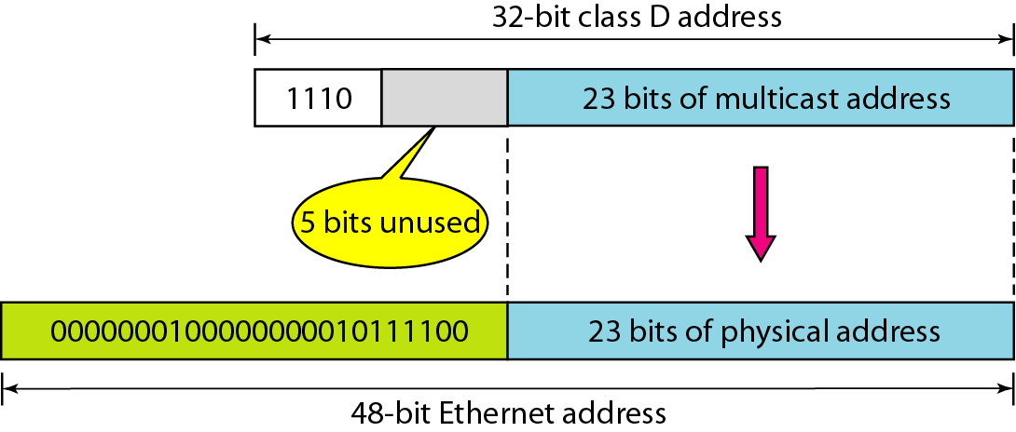
Figure 21.21 Mapping class D to Ethernet physical address

Slide 8

Note
An Ethernet multicast physical address is in the range
01:00:5E:00:00:00 to 01:00:5E:7F:FF:FF.

Slide 9
Example 21.7
Change the multicast IP address 230.43.14.7 to an Ethernet multicast physical address.
Solution
We can do this in two steps:
a. We write the rightmost 23 bits of the IP address in
hexadecimal. This can be done by changing the
rightmost 3 bytes to hexadecimal and then subtracting
8 from the leftmost digit if it is greater than or equal to
8. In our example, the result is 2B:0E:07.

Slide 10
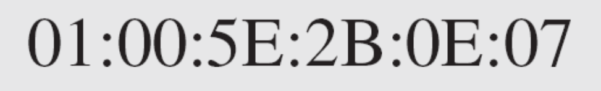
Example 21.7 (continued)
b. We add the result of part a to the starting Ethernet
multicast address, which is 01:00:5E:00:00:00. The
result is

Slide 11
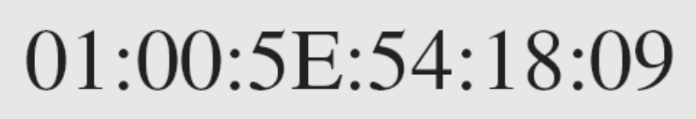
Change the multicast IP address 238.212.24.9 to an Ethernet multicast address.
Solution
a. The rightmost 3 bytes in hexadecimal is D4:18:09. We
need to subtract 8 from the leftmost digit, resulting in
54:18:09.
b. We add the result of part a to the Ethernet multicast
starting address. The result is

